Slide 2
Essential Question
The Incorporation of America
Industrialization increased the standard of living and the opportunities of most Americans, but at what cost?

Slide 3
Causes of Rapid Industrialization
Steam Revolution of the 1830s-1850s.
The Railroad fueled the growing US economy:
First big business in the US.
A magnet for financial investment.
The key to opening the West.
Aided the development of other industries.
Government issued land grants

Slide 4
Causes of Rapid Industrialization
Technological innovations.
Bessemer and open hearth process
Refrigerated cars
Edison
“Wizard of Menlo Park”
light bulb, phonograph, motion pictures.

Slide 5
Thomas Alva Edison
“Wizard of Menlo Park”

Slide 6
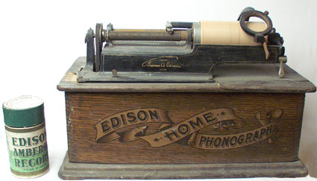
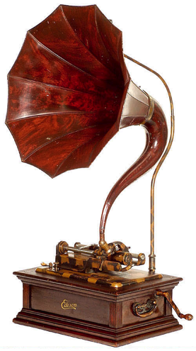
The Phonograph (1877)

Slide 7
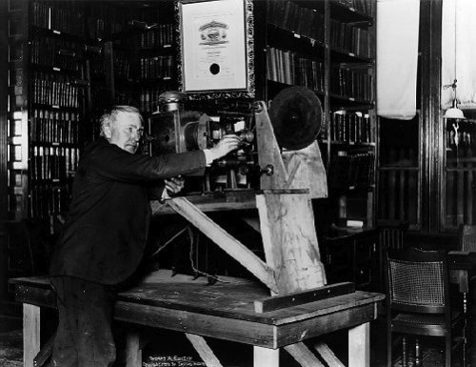
The Motion Picture Camera

Slide 8
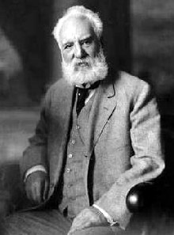
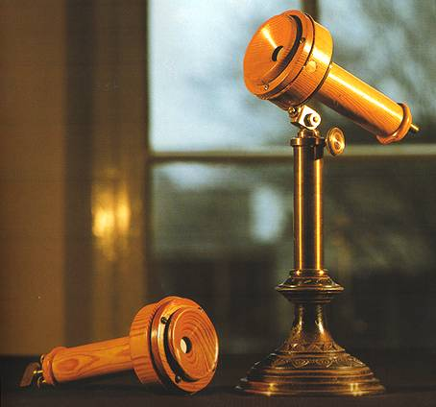
Alexander Graham Bell
Telephone (1876)

Slide 9
Alternate Current
George Westinghouse

Slide 10
Alternate Current
Westinghouse Lamp ad

Slide 11
The Airplane
Wilbur Wright Orville Wright
Kitty Hawk, NC – December 7, 1903

Slide 12
Model T Automobile
Henry Ford I want to pay my workers so that they can afford my product!

Slide 13
“Model T” Prices & Sales

Slide 14
U. S. Patents Granted
1790s → 276 patents issued.
1990s → 1,119,220 patents issued.

Slide 15
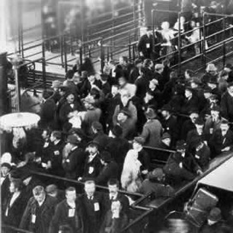
Causes of Rapid Industrialization
Unskilled & semi-skilled labor in abundance.
Abundant capital.
New, talented group of businessmen [entrepreneurs] and advisors.
Market growing as US population increased.
Government willing to help at all levels to stimulate economic growth.
Abundant natural resources.

Slide 16
New Business Culture
Laissez Faire → the ideology of the Industrial Age.
Individual as a moral and economic ideal.
Individuals should compete freely in the marketplace.
The market was not man-made or invented.
No room for government in the market!

Slide 17
2. Social Darwinism
British economist.
Advocate of laissez-faire.
Adapted Darwin’s ideas from the “Origin of Species” to humans.
Notion of “Survival of the Fittest.”
Herbert Spencer

Slide 18
New Business Culture: “The American Dream?”
Protestant (Puritan) “Work Ethic”
Horatio Alger [100+ novels]
Is the idea of the “self-made man” a MYTH??

Slide 19
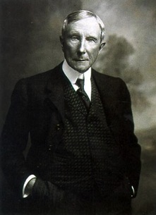
New Type of Business Entities
Pool 1887→ Interstate Commerce Act → Interstate Commerce Commission created.
Trust → John D. Rockefeller
Standard Oil Co.

Slide 20
Standard Oil Co.

Slide 21
New Type of Business Entities
Trust:
Horizontal Integration → John D. Rockefeller
Vertical Integration:
Gustavus Swift → Meat-packing
Andrew Carnegie → U. S. Steel

Slide 22
Iron & Steel Production

Slide 23
New Type of Business Entities

Slide 24
U. S. Corporate Mergers

Slide 25
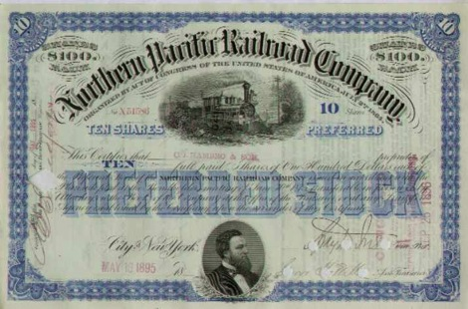
New Financial Businessman
The Broker:
J. Pierpont Morgan

Slide 26
The Reorganization of Work
The Assembly Line

Slide 27
% of Billionaires in 1900

Slide 28
% of Billionaires in 1918

Slide 29
The Protectors of Our Industries

Slide 30
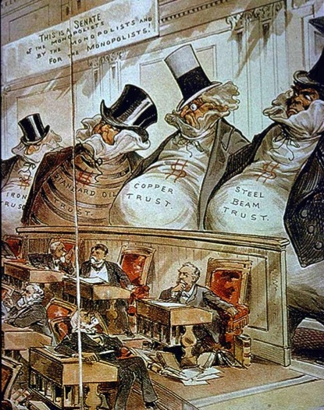
The ‘Bosses’ of the Senate

Slide 31
The ‘Robber Barons’ of the Past

Slide 32
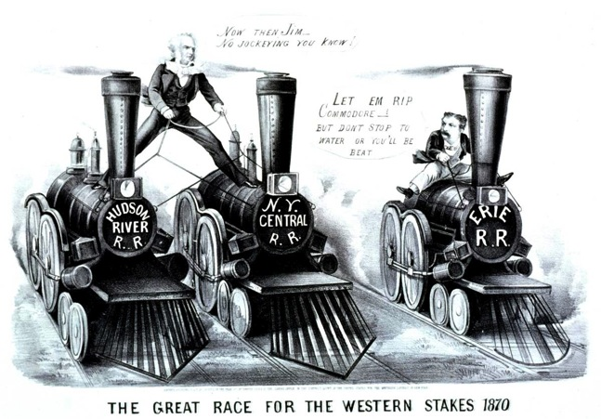
Cornelius [“Commodore”] Vanderbilt
Can’t I do what I want with my money?

Slide 33
William Vanderbilt
The public be damned!
What do I care about the law? H’aint I got the power?

Slide 34
The Gospel of Wealth: Religion in the Era of Industrialization
Wealth no longer looked upon as bad.
Viewed as a sign of God’s approval.
Christian duty to accumulate wealth.
Should not help the poor.
Russell H. Conwell

Slide 35
“On Wealth”
The Anglo-Saxon race is superior.
“Gospel of Wealth” (1901).
Inequality is inevitable and good.
Wealthy should act as “trustees” for their “poorer brethren.”
Andrew Carnegie

Slide 36
Regulating the Trusts
1877 → Munn. v. IL
1886 → Wabash, St. Louis & Pacific Railroad Company v. IL
1890 → Sherman Antitrust Act
in “restraint of trade”
“rule of reason” loophole
1895 → US v. E. C. Knight Co.

