Slide 1
The Rise of Organized Labor
Aim – What was it like to be an American worker in the industrial age?

Slide 2
Unfavorable Conditions
Working environments during the Gilded Age
Dangerous: thousands injured or killed each year.
Long Hours & Low Pay –
6-7 days/week
10-14 hrs. /day
$3-$12/week

Slide 3
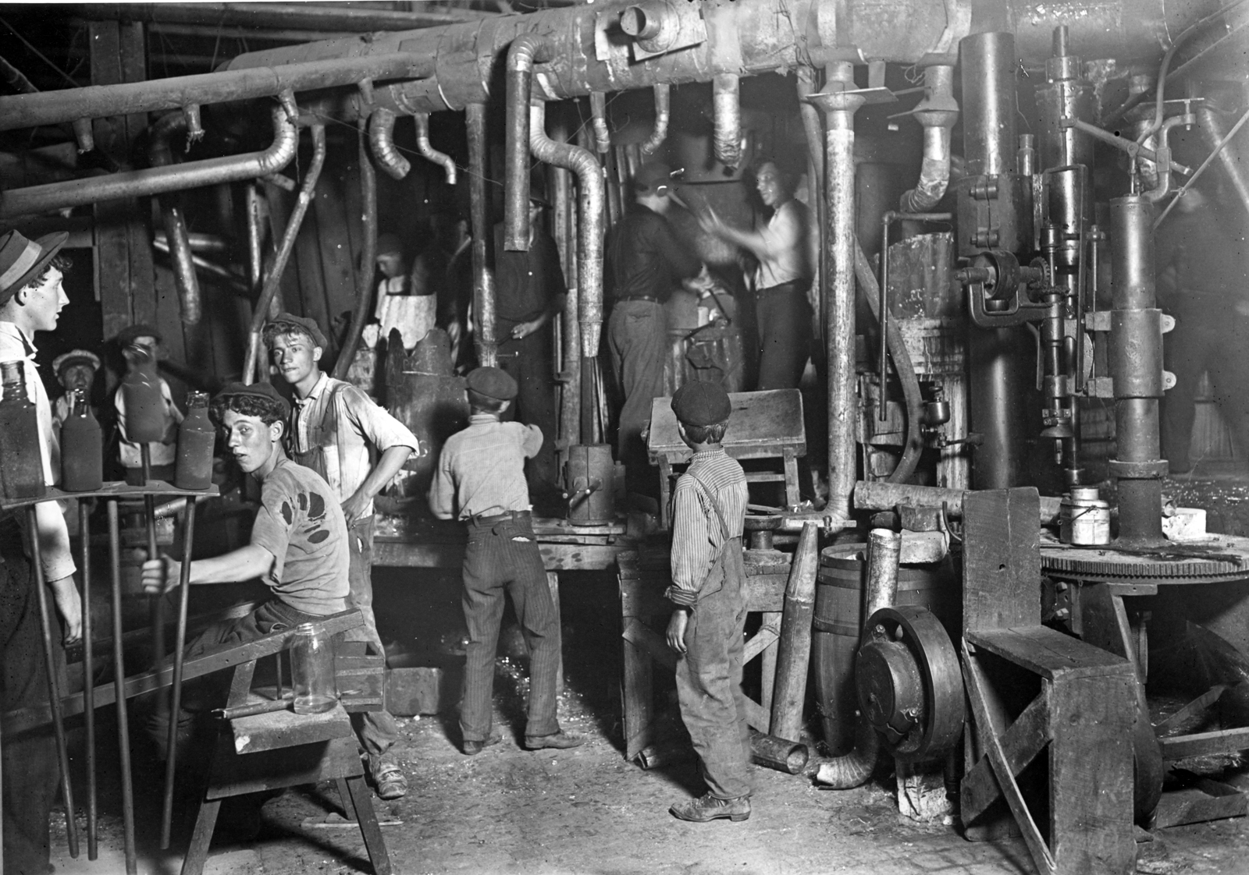
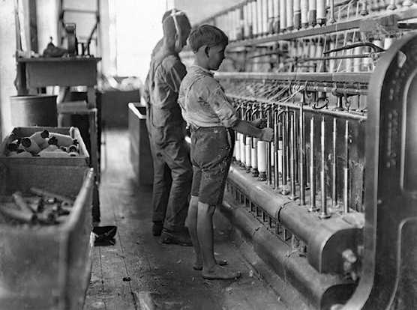
Paid the Least
Unskilled Workers with so formal training
Women & Children
Immigrants

Slide 4
What were the problems?
Impersonal, Boring, & Repetitive – no laws requiring safety or fair worker treatment
Monotonous work on a take it – or leave it basis.
No job security
No benefits
No insurance
No retirement plans
No sick-days.
Less skilled work was available – machines replaced craftsmen

Slide 5
Child Labor
1/5th of American children under the age of 15 were working in 1910. (20%)
Textile mills and mines usually hired them.
They missed their childhood & schooling.

Slide 6
Boys working in a textile mill
(unsafe conditions)

Slide 7
Cotton Sorting for Quality
(Look at guy on the right )

Slide 8
Coal Miner
(look at all his safety equipment)

Slide 9
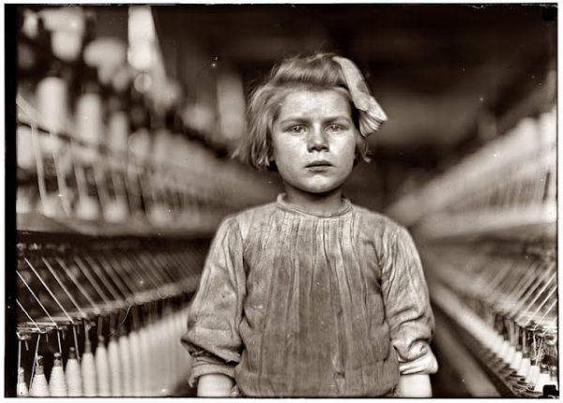
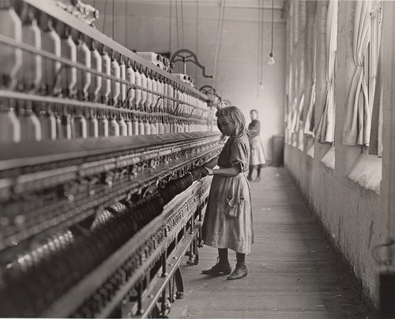
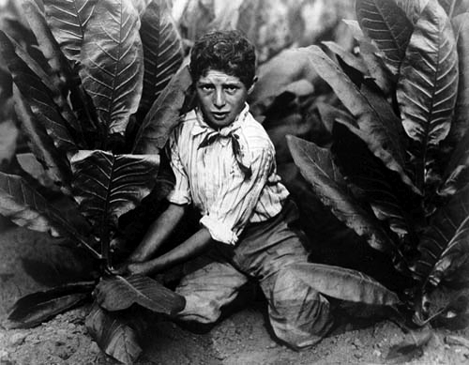
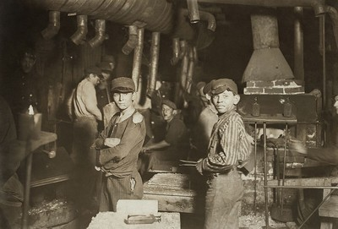

Slide 10
Rise of Labor Unions
Some formed unions to get better conditions
Most workers were unskilled and could be replaced easily, so workers needed to protect themselves.
Owners like Carnegie used cheaper immigrants or shut down rather than negotiate with unions.
Ford Paid workers more if they would NOT unionize

Slide 11
The First Attempt
Knights of Labor - 1st national labor union.
Founded by Terrance Powderly (1869)
joined skilled and unskilled workers.
admitted women after 1881 & equal pay for them.
demanded 8 hr. day, higher wages, & safer conditions.
opposed child labor.
supported restrictions on immigration.
grew rapidly in the 1880’s, but skilled worker resentment, being too loosely organized, and losing strikes caused them to fall apart.

Slide 12
Goals of All Labor Unions
End These Things:
Child Labor (kids work for less)
Unsafe Workplaces
Abusive treatment by bosses
No days off
Unrestricted immigration
(immigrants work for less)
Create these Things:
Shorter work day (8 Hours)
Higher wages
Worker benefits
Paid Vacation days
Compensation for workplace injuries
Retirement pensions

Slide 13
American Federation of Labor
(A.F.L.) – The first successful labor union
Formed in 1881 by Samuel Gompers.
Keys to success:
separate unions of skilled workers joined together into a federation made it successful. (no unskilled workers)
sought job security by seeking closed shops.
Closed Shops – workplaces where all workers had to be in the union for unity purposes
Use of the worker strike for leverage

