Slide 1
Aim -What opportunities and difficulties did immigrants face in the U.S. ?
Do Now:
Read “New Colossus”
by Emma Lazarus

Slide 2
The New Colossus
Not like the brazen giant of Greek fame, With conquering limbs astride from land to land; Here at our sea-washed, sunset gates shall stand A mighty woman with a torch, whose flame Is the imprisoned lightning, and her name Mother of Exiles. From her beacon-hand Glows world-wide welcome; her mild eyes command The air-bridged harbor that twin cities frame. "Keep, ancient lands, your storied pomp!" cries she With silent lips. "Give me your tired, your poor, Your huddled masses yearning to breathe free, The wretched refuse of your teeming shore. Send these, the homeless, tempest-tost to me, I lift my lamp beside the golden door!"
Emma Lazarus (1883)
What is the meaning of the section marked in red?

Slide 3
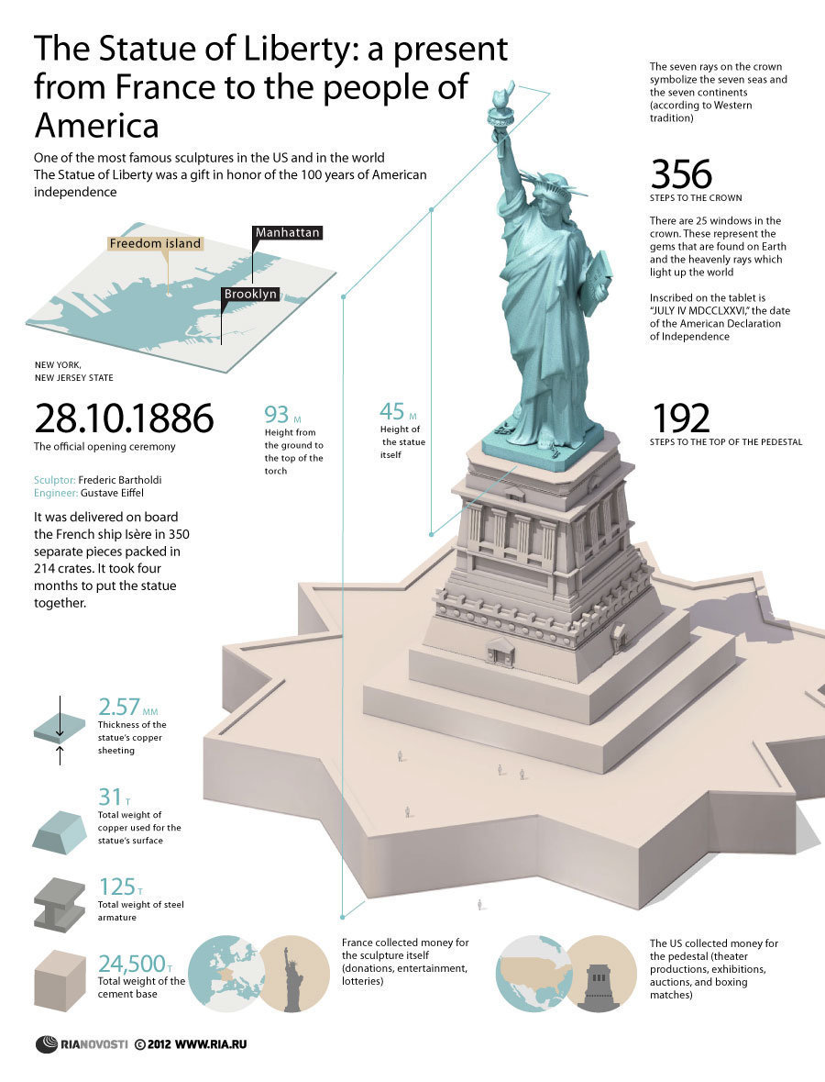
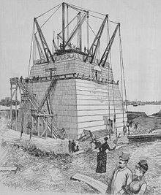

Slide 4
The “NEW” Immigrants
The Immigrant Experience
finding work
garment industry, steel mills, coal mines, unskilled factory jobs
Low paying, hazardous, long-hour work in crowded, dark, unsafe conditions.
*Sweatshops –
any working environment considered to
be unacceptably difficult or dangerous.

Slide 5
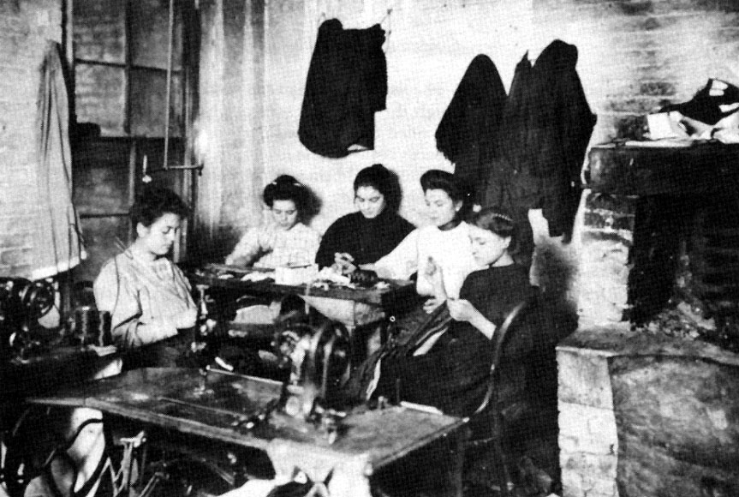
What is a sweatshop like?

Slide 6
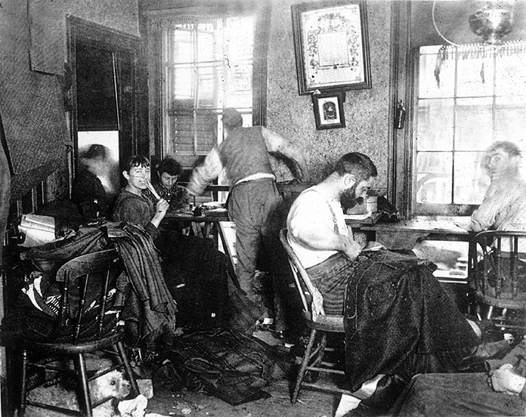

Slide 7
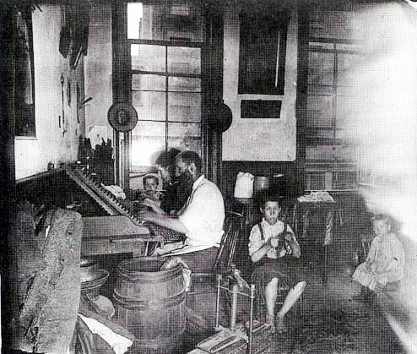

Slide 8
Assimilation of Immigrants
B. Adjusting to America
1. “New Immigrants” found it difficult to blend it
2. Old ways and new American freedoms conflicted
C. Building Communities
1. settled in communities with similar peoples
2. crowded into cheap apartments in cities
(Example: China Town, Little Italy)

Slide 9
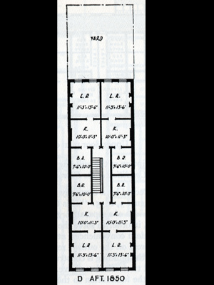
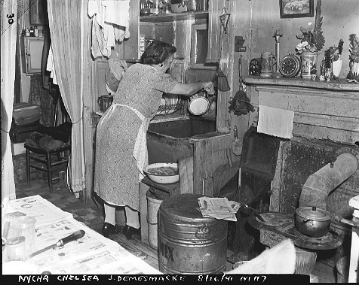
Tenement Apartments

Slide 10
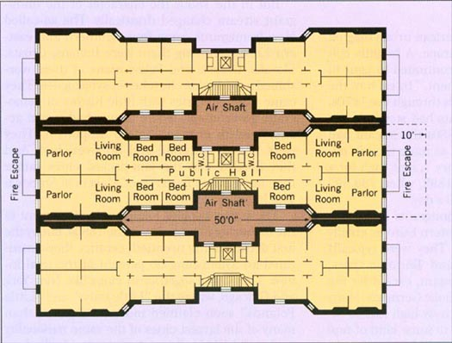
Dumb-bell Tenements

Slide 11
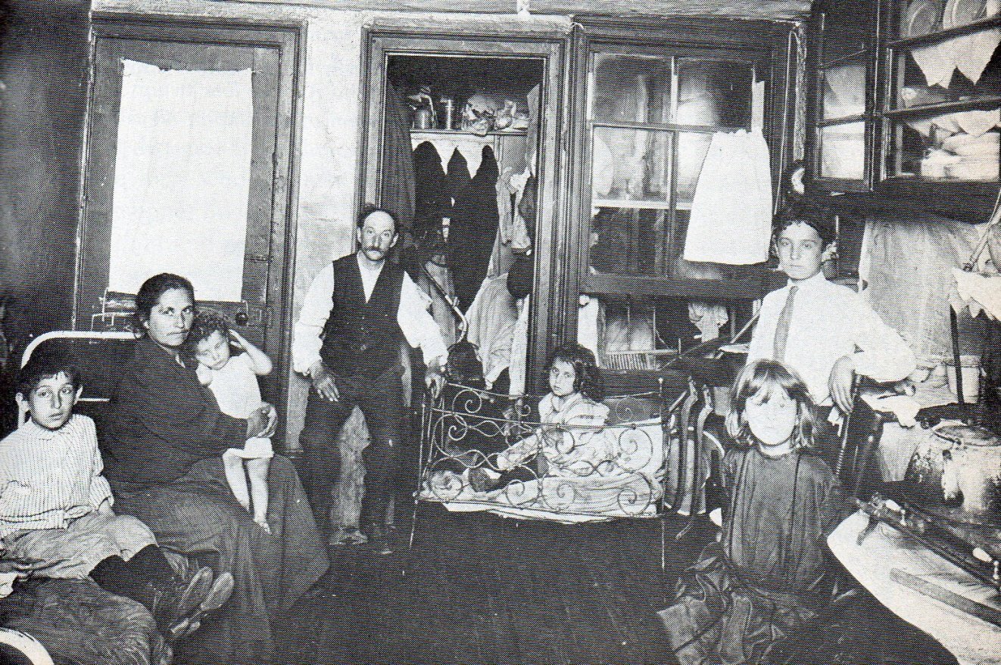
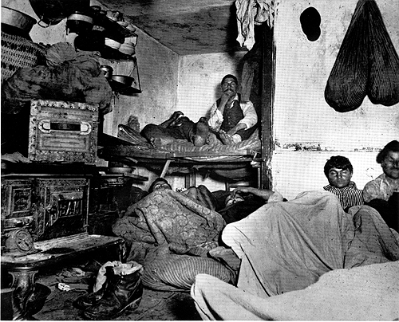

Slide 12
Opposition
II. Immigrants face opposition
A. Many Americans had negative view of foreigners
B. Nativists lead opposition to immigration
*Nativists –
A political group of Americans who believe immigration should be restricted.
Pressured politicians to pass laws limiting types and amounts of immigrants

Slide 13
III. Rise of Nativist Sentiment (feelings)
Native Born White Protestants
Many felt that immigrants could not fit in (acculturate, assimilate, etc.)
Nativists resented immigrants taking low paying jobs away from them.
Nativists discriminated against Jews, Catholics, Irish, Italians, Mexicans, Chinese
Pressure built until Nativists could influence politicians

Slide 14
IV. First Law passed by Congress:
Chinese Exclusion Act – 1882
Barred Chinese laborers from entering the country.
Prevented Chinese people who left the US from re-entering.
Why?
Chinese came in large numbers to build the railroads.
Americans did not understand Chinese customs.
As numbers of Chinese grew so did the amount of prejudice against them.

Slide 15
V. Immigration Limits – National Origins Act
Immigration Quotas of 1921 & 1924
Aimed at further restricting “Newer Immigrants”
Designed to slow the wave of Eastern and Southern European Immigrants
Too many “undesirable immigrants” were arriving too quickly between 1880 – 1920
Why?
Americans favored immigrants from cultures more similar to our own (W.A.S.P.s)

