Slide 1
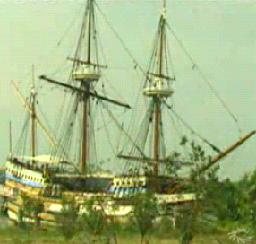
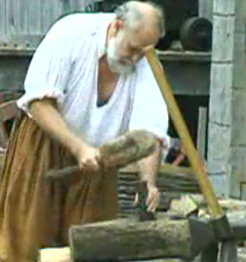
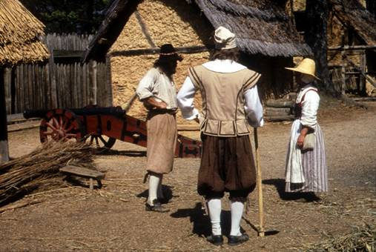
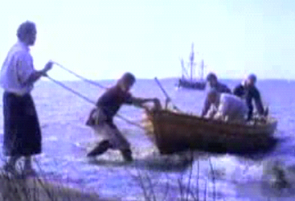
Jamestown Colony
First Successful English Colony in the New World

Slide 2


Reasons for English Colonization
England wanted to establish an American colony to increase her wealth and power.
  By finding silver and gold in America
  By providing a source of raw materials
  Would open new markets for trade.

Slide 3
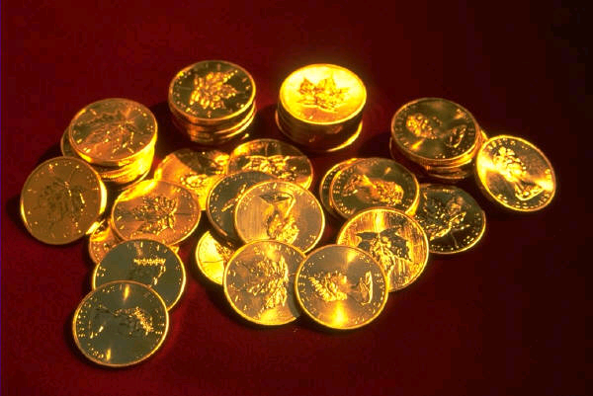
Why Settlers Came to Jamestown
Jamestown was primarily an economic venture.
The stockholders of the Virginia company of London financed the settlement of Jamestown.

Slide 4
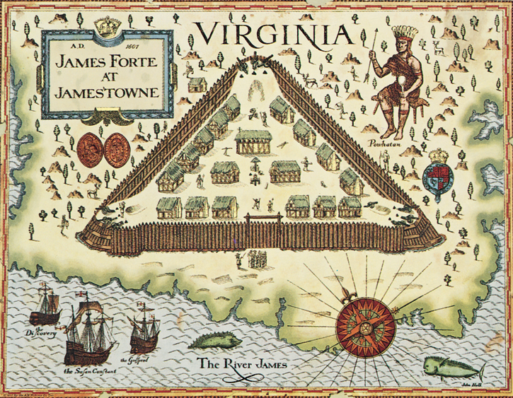
Jamestown became the first permanent
English settlement in north America in 1607.

Slide 5
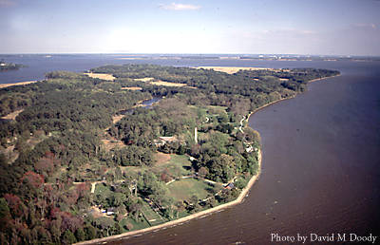
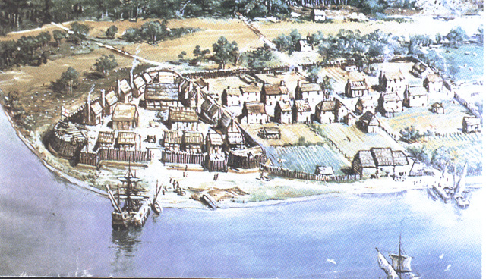
Location of Jamestown
When the settlers first arrived, Jamestown was located on a narrow peninsula bordered on three sides by the James River. Today Jamestown is located on an island in the James River.
Jamestown

Slide 6
Site of the Jamestown Colony

Slide 7
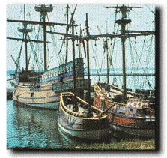
Reasons for the Location of Jamestown
The location could be easily defended from attack by sea by the Spanish.
The water along the shore was deep enough for ships to dock.
Believed to be a good supply of fresh water.

Slide 8
Virginia Company of London
The stockholders of the Virginia company of London financed the settlement of Jamestown

Slide 9
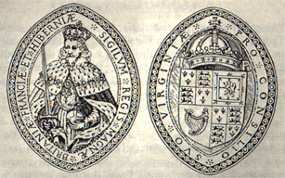
Virginia Charters
The King of England granted charters to the Virginia Company of London.
A charter is a document issued by a government authority.

Slide 10
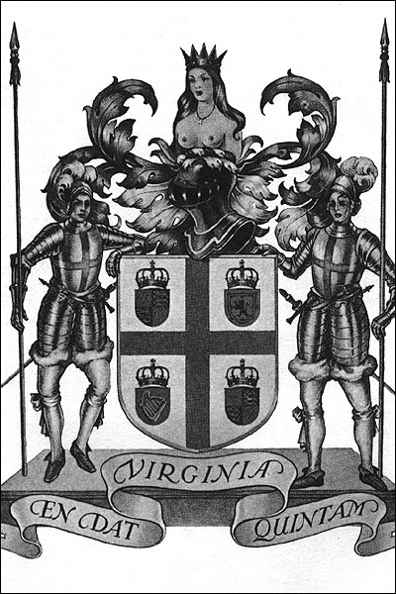
Importance of the Virginia Charters
The charters gave the Virginia Company the right to establish a settlement in North America.
The first charter of the Virginia Company of London established companies to begin colonies in the New World.
The charters extended English rights to the colonists.

Slide 11
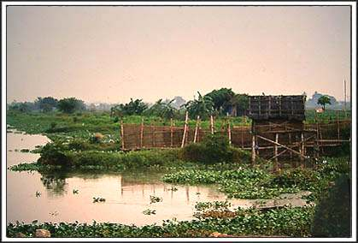
Hardships Faced By Settlers
The site they chose to live on was marshy and lacked safe drinking water.
The settlers lacked some skills necessary to provide for themselves.
Many settlers died of starvation and disease.

Slide 12
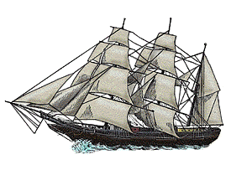
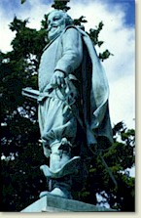
Changes That Ensured Survival
The arrival of two supply ships.
The forced work program and strong leadership of Captain John Smith
The emphasis on self-sustaining agriculture ensured survival of the colony.

Slide 13
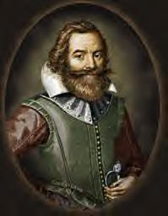
Captain John Smith
As leader of the Jamestown Colony he helped to restore order with one simple rule “He that will not work, will not eat.”
He also initiated trading relationships with the Powhatan Indian tribes lead by Chief Powhatan.
However, due to an injury he left the colony to return to England in 1609.

Slide 14
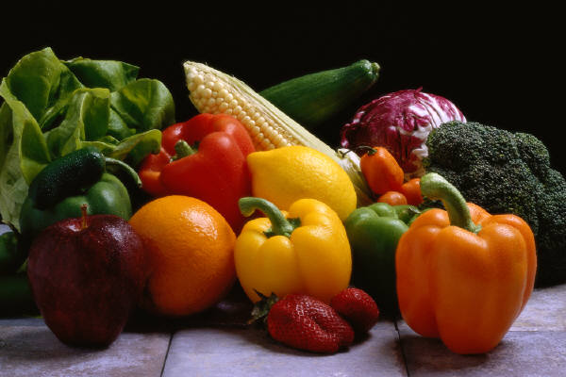
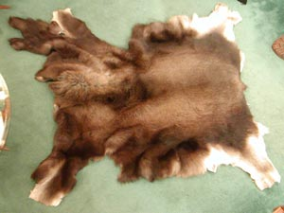
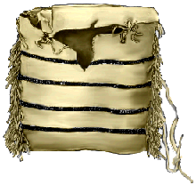
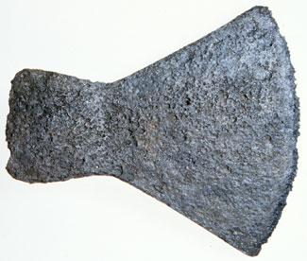
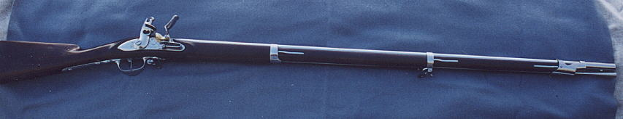
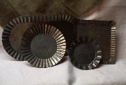
Trade With The Powhatan Indians
The Powhatans traded food, furs and leather with the English.
The English traded tools, pots, guns and other goods with the Powhatans.

Slide 15
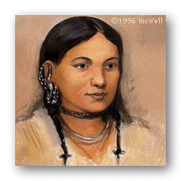
Pocahontas
Pocahontas, daughter of Chief Powhatan, believed the English and American Indians could live in harmony.
Pocahontas began a friendship with the colonists that helped them survive.

Slide 16
Powhatans – Corn and Tobacco
The Powhatans introduced new crops to the English, including corn and tobacco.

Slide 17
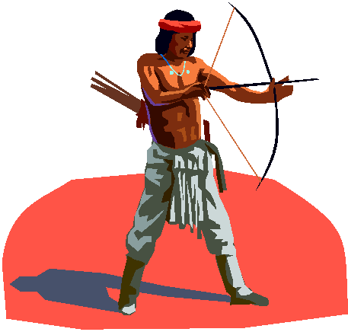
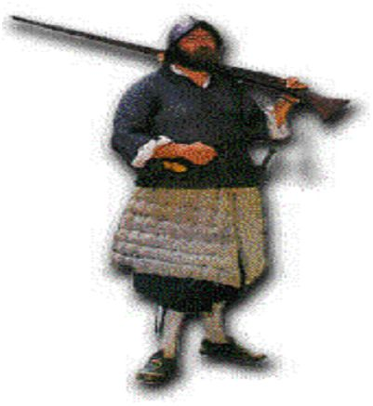
Powhatans & Jamestown: Growing Conflict
The Colonists began stealing and attempting to intimidate the Indians.
The Powhatans realized the English settlement would continue to grow and saw the colonists as invaders that would take over their land.

Slide 18
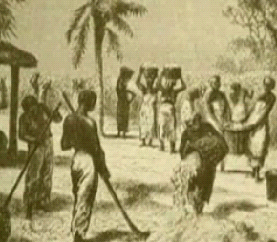
Africans Come to Jamestown
Africans arrived in Jamestown against their will in 1619.
It is believed that they arrived as baptized Christians and therefore were labeled indentured servants for a period of 5 to 7 years.
The arrival of Africans made it possible to expand the tobacco economy.

Slide 19
Assessment – 1 of 3
Who helped restore order to the Jamestown Colony with one simple rule “He that will not work, will not eat?” Answer
What made it possible to expand the tobacco economy? Answer
Who financed the settlement of Jamestown? Answer
Click here to go to Assessment #2

Slide 20
Assessment – 2 of 3
What two crops did the Powhatans introduce to the English? Answer
Why did the English want to establish an American colony? Answer
What did the charters extend to the Jamestown colonists? Answer
Click here to go back to Assessment #1
Click here to go to Assessment #3

Slide 21
Assessment – 3 of 3
What effect did the arrival of women at Jamestown have on the Colony? Answer
What were three reasons for the location of the Jamestown Colony? Answer
What hardships were faced by the Jamestown colonists? Answer
Click here to go back to Assessment #2

Slide 22
Captain John Smith
To restore order Captain John Smith had one simple rule “He that will not work, will not eat.”

Slide 23
Expansion of the Tobacco Economy
The arrival of Africans made it possible to expand the tobacco economy.

Slide 24
Powhatans: Crops
The Powhatans introduced new crops to the English, including corn and tobacco.

Slide 25
Reasons for English Colonization
England wanted to establish an American colony to increase her wealth and power.
  By finding silver and gold in America
  By providing a source of raw materials
  Opening new markets for trade.

Slide 26
Virginia Charters
The charters extended English rights to the colonists

Slide 27
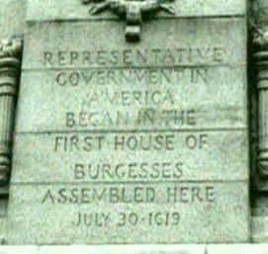
Jamestown: The Growth of Government
In 1619, the governor of Virginia called a meeting of the Virginia Assembly.
By the 1640s, the burgesses became a separate legislative body, called the Virginia House of Burgesses.

Slide 28
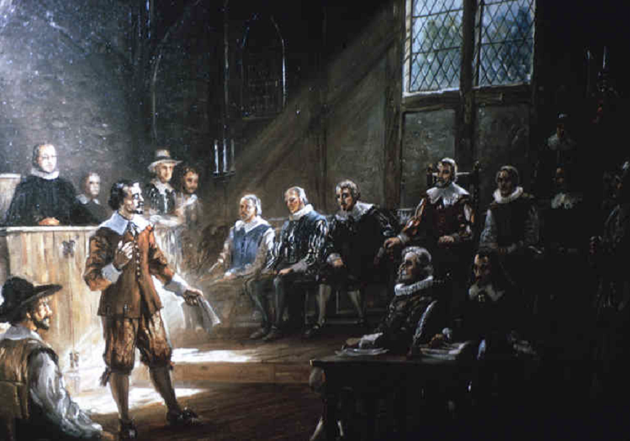
Virginia House of Burgesses
The Virginia house of burgesses was the first elected legislative body in America giving settlers the opportunity to control their own government.
It became the General Assembly of Virginia, which continues to this day.

Slide 29
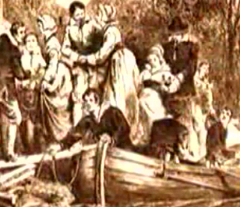
Women Come to Jamestown
The first women settlers came Jamestown in 1620.
The arrival of women made it possible for the settlers to establish families and a more permanent settlement at Jamestown.

Slide 30
Women Arrive At Jamestown
The arrival of women to Jamestown in 1620 made it possible for the settlers to establish families and a more permanent settlement at Jamestown.

Slide 31
Reasons for the Location of Jamestown
The location could be easily defended from attack by sea by the Spanish.
The water along the shore was deep enough for ships to dock.
Believed to be a good supply of fresh water.

Slide 32
Hardships Faced By Settlers
The site they chose to live on was marshy and lacked safe drinking water.
The settlers lacked some skills necessary to provide for themselves.
Many settlers died of starvation and disease.

Slide 33
Credits
Virginia Studies Curriculum Framework, Commonwealth of Virginia, Board of Education, 2001
Virginia Studies Posters (http://chumby.dlib.vt.edu/melissa/posters/vastudiesposter.html)
Google Image Search (www.google.com/images)

