Slide 1
United States Government Relations with Indian Peoples
Aim – How did the movement west help end the Native American way of life?

Slide 2
Native American way of Hunting

Slide 3
US - American Way of Hunting

Slide 4
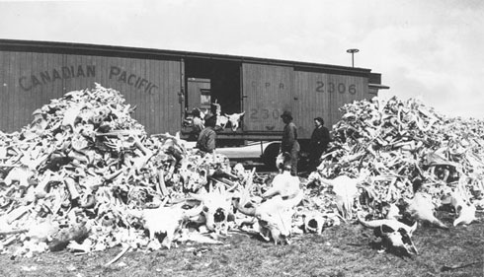

Slide 5
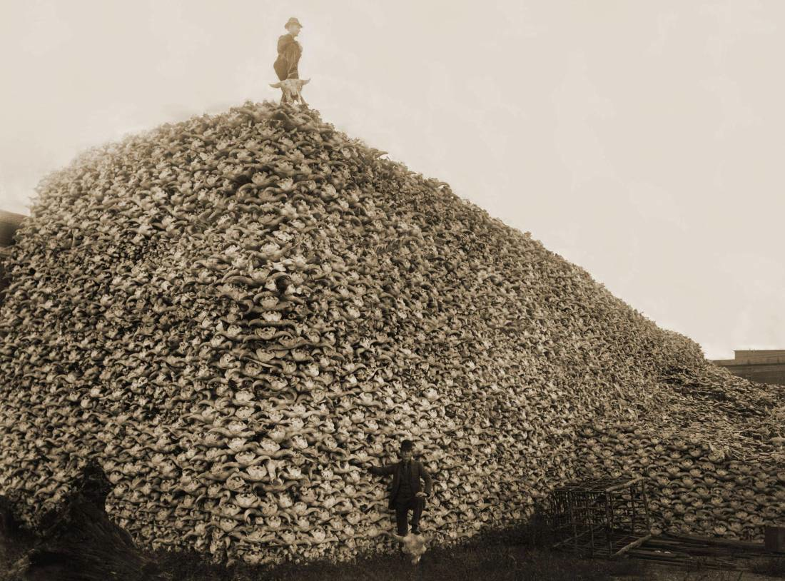

Slide 6
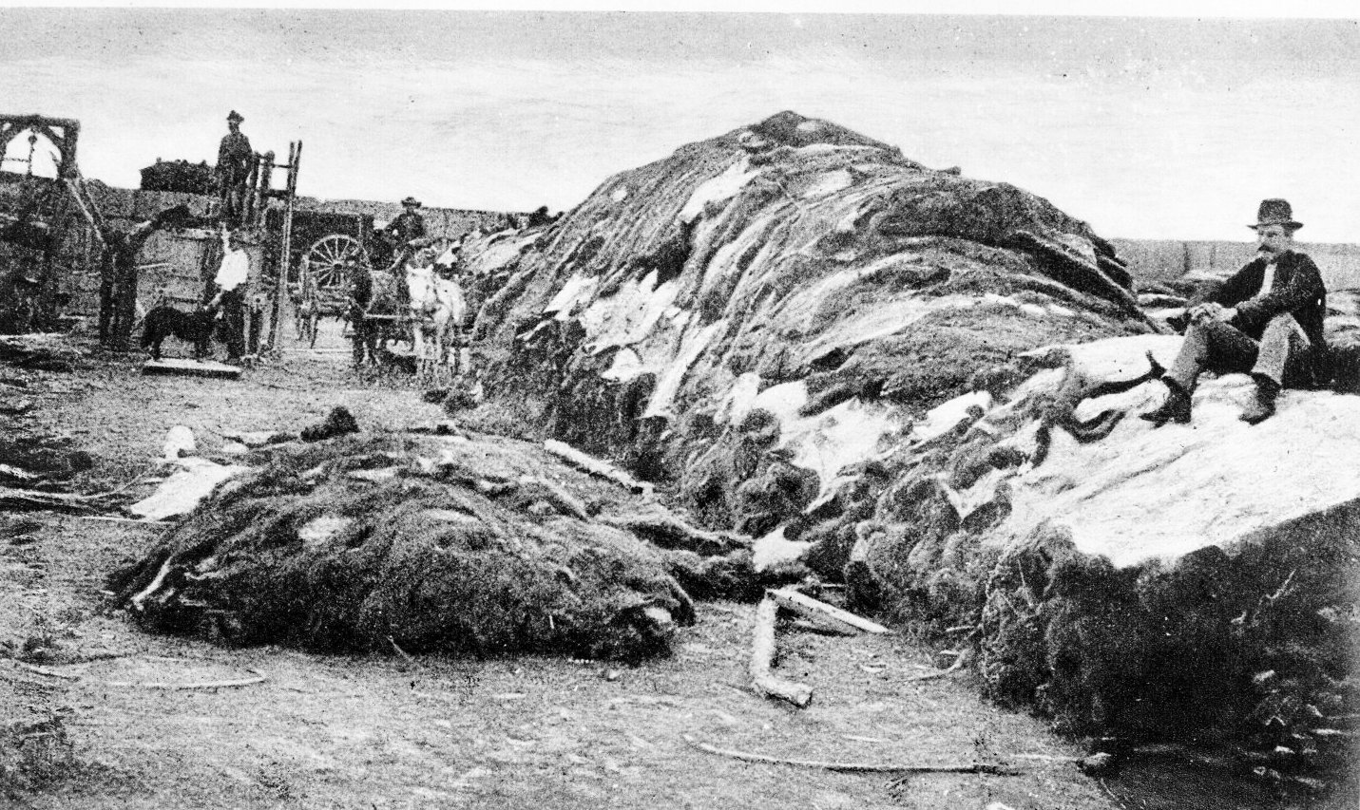

Slide 7
Extent of the Bison Range - 1889

